Slide 1

Sales Analysis Dashboard
Presented By: Raunak Sen

Slide 2

Company Background
Amazon is an American multinational e-commerce company that faces various challenges while running its business. To address these problems, the company leverages data-driven insights for operations optimization.
This analysis aims to provide a comprehensive overview of sales performance, identify key challenges, and propose data-backed solutions to enhance efficiency and customer satisfaction.

Slide 3
Problem Statement
Inconsistent Sales Growth
High Cancellation & Return Rates
Shipping Delays
Delays in shipping, especially from merchant-fulfilled orders, are leading to poor customer experience.
Sales performance varies across months and regions, making it hard to predict whether growth will occur.
A significant portion of orders are cancelled or returned, indicating potential issues in product quality, customer expectations, or delivery experience.
Limited Customer Insights
Inventory Mismanagement
The company lacks detailed insight into customer segments, regional performance, and retention behavior.
Stockouts or overstocking of certain products affects both customer satisfaction and operational costs.

Slide 4






Solution Approach
Revenue Trend Analysis
Returns & Cancellations
Identify high-sales months from revenue trend analysis and plan promotions accordingly.
Use data to identify products or SKUs with high return/cancellation rates for targeted improvement.
Delivery Optimization
Inventory Planning
Encourage migration to Amazon FBA or Easy Ship for better delivery success rates.
Use average quantity ordered and sales trends by category/size to plan inventory replenishment.
Customer Segmentation
Data Processing
Segment customer orders using the B2B field in the dataset for tailored strategies.
Utilize Python for EDA and data cleaning, then Power BI for dashboard visualization.

Slide 5

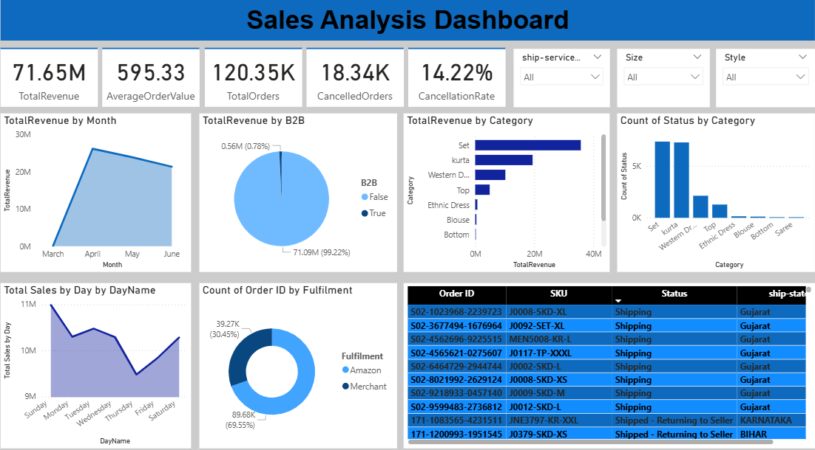
Sales Performance Dashboard
The interactive dashboard provides a comprehensive view of sales metrics, enabling drill-down analysis into various segments and performance indicators.

Slide 6
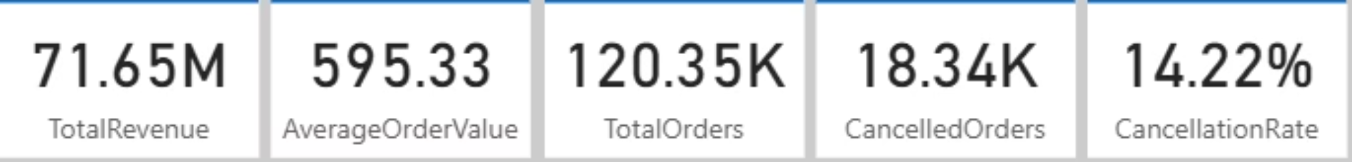
Key Performance Indicators (KPIs)
1
2
3
Total Revenue
Average Order Value (AOV)
Total Orders
Indicates the total sales amount generated over the entire period analyzed, reflecting overall business volume.
Calculated as total revenue divided by the total number of orders, indicating the average spend per transaction.
Represents the total number of distinct orders placed, a key metric for gauging customer engagement.
4
5
Cancelled Orders
Cancellation Rate
Identifies the total count of orders that were cancelled, highlighting potential areas for operational improvement.
Describes the percentage of orders that were cancelled, indicating the efficiency of order fulfillment and customer satisfaction.

Slide 7
DAX Formulas Used in Power BI
TotalRevenue = SUM('sales_dataset[1]'[Cleaned_Amount])
AverageOrderValue = DIVIDE(SUM('sales_dataset[1]'[Cleaned_Amount]), DISTINCTCOUNT('sales_dataset[1]'[Order ID]))
TotalOrders = DISTINCTCOUNT('sales_dataset[1]'[Order ID])
CancelledOrders = CALCULATE(COUNTROWS('sales_dataset[1]'), 'sales_dataset[1]'[Status] = "Cancelled")
CancellationRate = DIVIDE(CALCULATE(COUNTROWS('sales_dataset[1]'), 'sales_dataset[1]'[Status] = "Cancelled"), COUNTROWS('sales_dataset[1]'))
These DAX (Data Analysis Expressions) formulas are crucial for calculating the key metrics displayed on the Power BI dashboard, ensuring accurate and dynamic data insights.

Slide 8
Key Findings
1
Strong Revenue Performance
The company generated 71.65 million rupees during the analysis period, indicating strong sales activity across multiple categories and channels.
2
April's Peak Sales
April recorded the highest sales at over 10.2 million, a significant revenue spike suggesting successful campaigns or seasonal demand.
3
High Order Volume
Total orders reached 120,350 with an Average Order Value of 595.33, driven by affordable fashion SKUs.
4
Significant Cancellations
18,340 orders were cancelled (14.22% cancellation rate), meaning 1 in 7 orders is cancelled, leading to revenue leakage and poor customer experience.
5
FBA Superiority
Amazon-fulfilled orders show lower cancellations and faster delivery compared to merchant-fulfilled orders.
6
Top Performing Regions & Categories
Mumbai, Bengaluru, and Chennai are top cities. Kurtas, Sets, and Tops are best-selling categories, driving major revenue.
7
B2B vs. B2C Insights
B2B is a minority, but B2B transactions tend to have larger quantities and higher value per transaction, suggesting tailored segmented strategies could improve performance.

Slide 9







Strategic Recommendations
Reduce Cancellations
Identify top reasons for the 18.34K cancelled orders to implement targeted solutions.
Optimize Inventory
Increase inventory for high-demand categories (Western Wear, Sets, Ethnic Dresses), especially during peak months.
Enhance B2B Engagement
Offer bulk discounts and loyalty perks to B2B customers, leveraging their higher transaction value.
Seasonal Campaign Planning
Run pre-April marketing campaigns and stock up early, anticipating peak revenue.
Prioritize FBA Fulfillment
Increase the percentage of orders fulfilled by Amazon for better reliability and customer satisfaction.
Leverage Daily Trends
Run flash deals or targeted email campaigns on historically high-sales days.
Regional Logistics
Prioritize faster delivery and zonal warehousing in high-demand regions like Gujarat, Karnataka, and Bihar.

Slide 10

Thank You
For further inquiries or collaboration, please connect via:
GitHub ID: https://github.com/raunaksen26101997
LinkedIn ID: https://www.linkedin.com/in/raunak-sen-6a9848184/

